Slide 1


K.RAMAKRISHNAN COLLEGE OF TECHNOLOGY
(AUTONOMOUS), TRICHY
HASH TABLE-BASED SPELL CHECKER
PRESENTED BY:
SUBASH R
-2303811720521052
Notes:
1

Slide 2
PRESENTATION OVERVIEW
Problem Identification
Objective
Proposed system
Block diagram of proposed system
Data structures used
Modules
Module Description
Module Implementation
Source Code
Screenshot
Conclusion and Future Enhancement
Notes:
2

Slide 3
PROBLEM IDENTIFICATION
Frequently Misspelled Words Many people struggle with spelling common words correctly, leading to embarrassing errors in their written work.
Consistency Issues Inconsistent spelling across a document can make it appear unprofessional and detract from the overall quality of the writing.
Time-Consuming Proofreading Manually checking for spelling mistakes is a tedious and time-consuming process, especially for longer documents.
2/7/20

Slide 4
OBJECTIVE
Efficient Word Lookup
Leverage the speed and performance of hash tables to quickly look up and validate words.
Accurate Suggestions
Provide users with relevant spelling suggestions for misspelled words.
Customizable Dictionary
Allow users to add or remove words from the dictionary to suit their needs.
Notes:
4

Slide 5
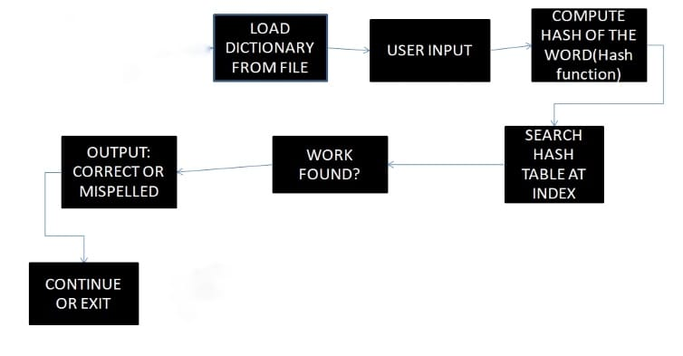
PROPOSED SYSTEM
BLOCK DIAGRAM
Notes:
5

Slide 6
DATA STRUCTURES USED
A spell checker implemented using data structures like hash tables can efficiently store and check the correctness of words in a dictionary. These data structures enable fast lookups and comparisons, crucial for spell checking large text files or user input.
Notes:
6

Slide 7
ADVANTAGES OF PROPOSED SYSTEM
Accuracy Accurately identifies and corrects a wide range of common spelling errors, ensuring flawless written communication.
Efficiency Streamlines the proofreading process, saving time and effort by automating the detection and correction of spelling mistakes.
Consistency Maintains consistent spelling across documents and within an organization, improving the overall quality and readability of written content.
Notes:
7

Slide 8
Module Description
This program implements a basic spell checker using a hash table data structure. It consists of several modules:1. Node Structure: Defines a structure for each word in the hash table, containing the word itself and a pointer to the next node.2. Hash Table Structure: Defines the hash table structure, which is an array of pointers to nodes.3. Hash Function: Computes the hash value for a given word.4. Initialize Hash Table: Initializes a new hash table.5. Insert Word: Inserts a word into the hash table.6. Check Word: Checks if a word exists in the hash table.7. Free Hash Table: Frees memory allocated for the hash table.
Notes:
8

Slide 9
Module Implementation
The hash function calculates the hash value for a word by iterating over each character and updating the hash value using a multiplication and addition operation.
Memory is dynamically allocated for the hash table and nodes.
Words are inserted into the hash table by calculating
Notes:
9

Slide 10
Source Code
// Function to compute hash value
int hash(char* word) {
int hashValue = 0;
for (int i = 0; word[i] != '\0'; i++) {
hashValue += word[i];
}
return hashValue % TABLE_SIZE;
}
// Function to insert a word into the hash table
void insert(HashTable* ht, char* word) {
int index = hash(word);
Node* newNode = (Node*)malloc(sizeof(Node));
if (newNode == NULL) {
printf("Memory allocation failed!\n");
return;
}
strcpy(newNode->word, word);
newNode->next = ht->table[index];
ht->table[index] = newNode;
}
// Function to check if a word is in the hash table
int check(HashTable* ht, char* word) {
int index = hash(word);
Node* current = ht->table[index];
while (current != NULL) {
if (strcmp(current->word, word) == 0) {
#include <stdio.h>
#include <stdlib.h>
#include <string.h>
#define TABLE_SIZE 100
// Node structure for linked list
typedef struct Node {
char word[50];
struct Node* next;
} Node;
// Hash table structure
typedef struct {
Node* table[TABLE_SIZE];
} HashTable;
// Function to initialize the hash table
void initHashTable(HashTable* ht) {
for (int i = 0; i < TABLE_SIZE; i++) {
ht->table[i] = NULL;
}
}
Notes:
10

Slide 11
Source Code
insert(&ht, word);
}
// Spell checking
printf("Enter a word to check if it's in the hash table: ");
scanf("%s", word);
if (check(&ht, word)) {
printf("The word '%s' is spelled correctly!\n", word);
} else {
printf("The word '%s' is misspelled!\n", word);
}
return 0;
}
return 1; // Word found
}
current = current->next;
}
return 0; // Word not found
}
int main() {
HashTable ht;
initHashTable(&ht);
// Input words into the hash table
printf("Enter words to insert into the hash table (type 'done' to stop):\n");
char word[50];
while (1) {
scanf("%s", word);
if (strcmp(word, "done") == 0) {
break;
}
Notes:
11

Slide 12
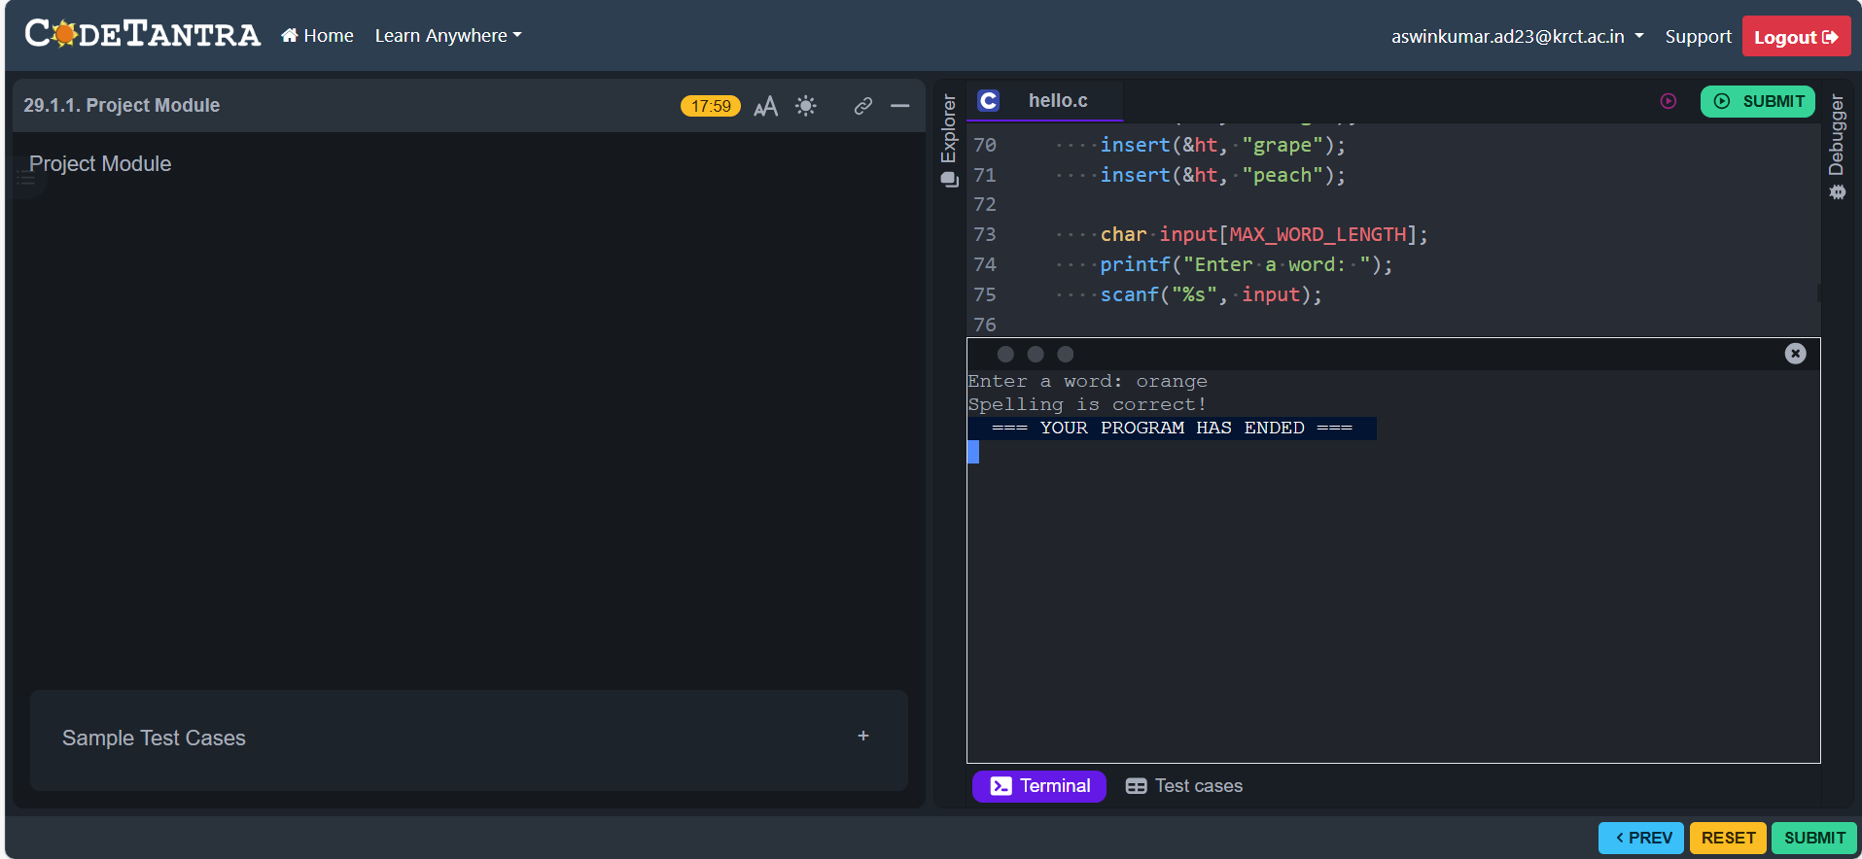
Screenshot
Notes:
12

Slide 13
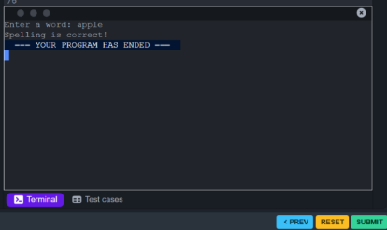
Screenshot
Notes:
13

Slide 14
Conclusion and Future Enhancement
Conclusion:
This program provides a simple yet effective spell checking mechanism using a hash table. It efficiently stores words and allows for quick lookups. However, it has limitations such as not handling collisions effectively and lacking advanced features like suggestions for misspelled words.
Future Enhancements:
Collision Resolution: Implementing a more robust collision resolution technique such as chaining or open addressing would improve the hash table's performance.
2. Suggestions for Misspelled Words : Enhancing the program to provide suggestions for misspelled words based on similar words in the dictionary.
Notes:
14

Slide 15
THANK YOU
Notes:
15

